Slide 1
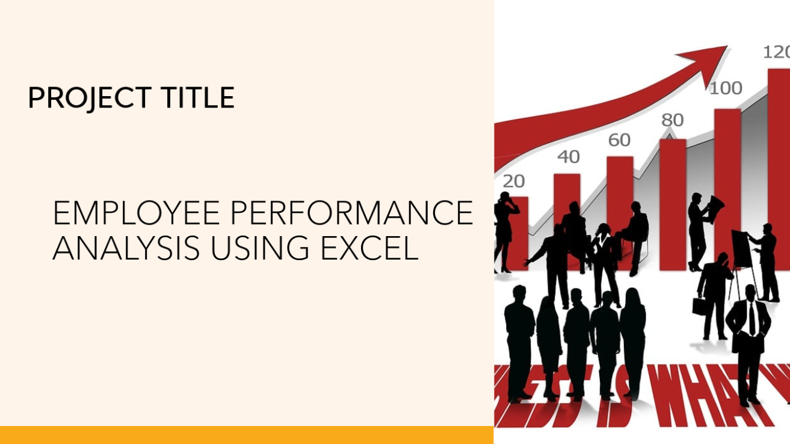

Employee data analysis using excel
STUDENT NAME: BHAKYADHARSHINI. S
REGISTER NO: 312214992
USERNAME: asunm148512214992
DEPARTMENT: BCOM COMMERCE
COLLEGE: SOKA IKEDA COLLEGE OF ARTS AND SCIENCE

Slide 2

Employee Performance Analysis Using Excel
PROJECT TITLE

Slide 3
Agenda
Problem Statement
Project Overview
End Users
Our Solution and Proposition
Dataset Description
Modelling Approach
Results and Discussion
Conclusion

Slide 4
Problem statement
Predicting Sales Forecast: Develop a model to predict sales forecast for a company based on historical sales data, seasonality, and market trends.
Optimizing Supply Chain: Analyze the supply chain of a company and develop a model to optimize inventory levels, reduce costs, and improve delivery times.
Customer Segmentation: Segment customers based on their buying behavior, demographic data, and preferences to develop targeted marketing campaigns.

Slide 5
Project overview
Employee analysis is the process of evaluating an employee's performance, skills, and contributions to the organization.
Objective: To analyze and evaluate employee performance. identify areas of strength and improvement, and provide insights for informed decision-making.

Slide 6

Who are the end users ?
Employees
Organization
Manager

Slide 7
Our solution and its value proposition
Conditional formatting- missing (exit date).
Filter- remove blanks.
Formula- performance Category
=IFS(Z8>=5,"VERY HIGH",Z8>=4,"HIGH",Z8>=3,"MEDIUM",TRUE,"LOW")
Pivot-summary
Graph- data visualiztion

Slide 8
Dataset description
We took the employee datas from kaggle website. We have 26 features totally.But, We used only 9 of the features.We entered the name of the employees in Alphabetical order. And we also enterd the employee type in Alphabetical order.We entered the performance level of the employee in Numerical value.We entered the gender of the employees as Male/Female.We entered the data of employee rating in Numerical value.We entered the Business unit in Alphabetical order.

Slide 9
The “wow” in your solution
(i)=IFS(Z8>=5,”VERY HIGH”,Z8>=4,”HIGH”,Z8>=3,”MEDIUM,”TRUE,”LOW”
(ii)The above formula used to catagories the performance level of the employee is consider
as “WOW’ in my project

Slide 10
modelling
DATA COLLECTIONS:
1.Dashboard
2.By formatting the dataset
FEATURES COLLECTIONS:
1.Data is collected from the dashboard
2.Formatting the data to find the employees performance level
DATA CLEANING:
1.Identifying the missing values
2.Filter outing the missing values
PERFORMANCE LEVEL:
1.Employees High Performance Level
2.Employees Low Performance Level
SUMMARY:
1.Categories the performance level of the employees

Slide 11
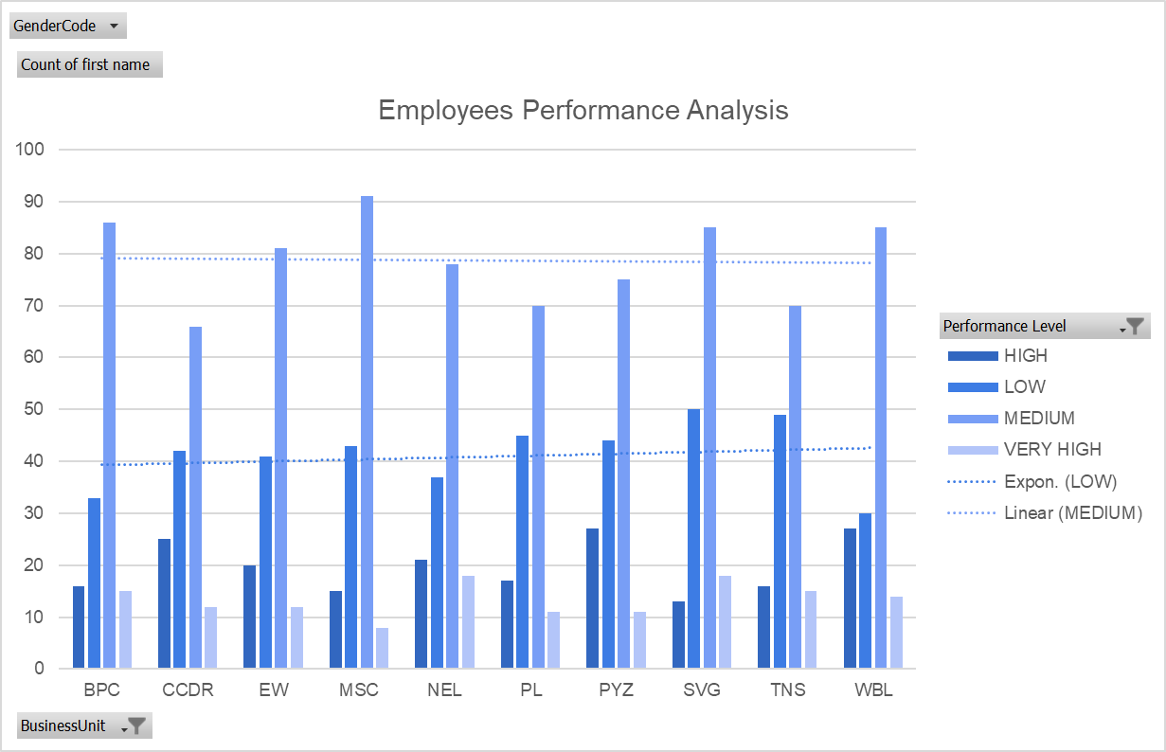
Results

Slide 12
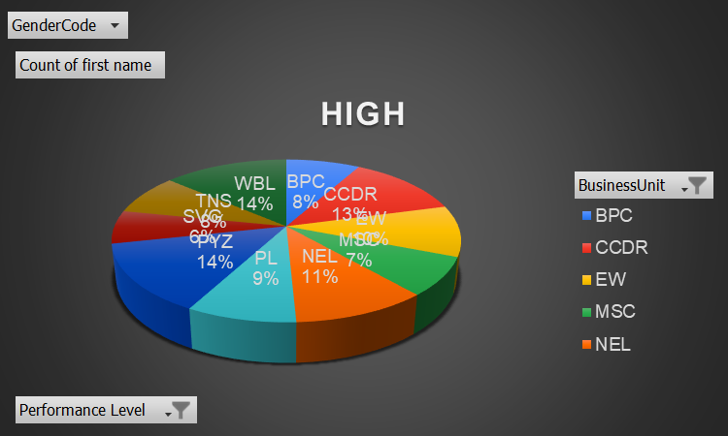
Results

Slide 13
Conclusion
With targeted encouragement and motivation, medium-level performing employees can be developed into high-performing employees, leading to a gradual increase in overall performance trends. By recognizing and building on their strengths, providing tailored support and resources, and fostering a growth-oriented culture, organizations can unlock the full potential of their workforce and drive sustained improvement in performance outcomes.

Slide 14
Thank you

